Slide 1
Mini Project Presentation
Project title- hangman game
NAME:- ARSH SRIVASTAVA
ROLL NO- 2000320130042
IT-A

Slide 2
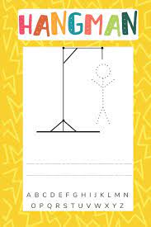
CONTENTS
Introduction
Requirement of Projects
Required Functionality of the Game
Scenario to be Covered
Project Prerequisites
Future Plan

Slide 3
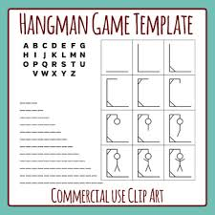
INTRODUCTION
The Hangman Game in Python is written in python programming language, in this Hangman Game Project is to implement the Hangman Game using Python.
It doesn’t require any specific modules other than random and time. Python loops and functions are enough to build this game here.
A Hangman Game On Python is about guessing letters(A-Z) to form the words. If the player guesses the right letter appears at its correct positions. The user has to guess the correct word u

Slide 4

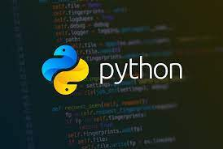
REQUIREMENTS OF PROJECTS
Language used-
Python
Python loop and functions are enough to buILD hangman game

Slide 5
Required Functionality of The Game
Program assumes a random word, and gives a hint as how many letters are present in that word.
Each player has 10 chances to find the correct word as assumed by program.
The Program can take either a single letter as input or the word is input
If the user input the single letter. Then , if that particular letter is present in assumed word of program, then, the program return that particular letter’s position in that word .
For example :- If the program’s assumed correct word is →FACEBOOK
& if the user has input the letter as →O
then, the program should return as → *****OO*
( That means giving the hint to the user about the position of input letter in the correct word )
If the user guess the right word , then the program should display the – confirmation message with number of moves made by user to guess the right word.
If the user is unable to guess the right word after 10 chances , then the program should display the right word selected by the program.

Slide 6
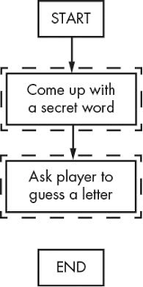
Scenario to be covered:-
User Guesses Right word & system should display the output with number of chances user by user.
User is unable to guess the right word after 10 moves , then program should display the right word.
User inputs the wrong word as input , then proper instruction should be provided to the user.

Slide 7
Project Prequisities
This Project requires good knowledge of Python which includes defining functions and managing for/while loops. The functions that we use here contain arguments that are defined in a global scope which can be further used in other functions to improve game quality. It can also be used to provide different steps when required to execute upon conditions by the for and while loops.

Slide 8
Future Plan
→ I would like to add functionalities using Python in Future.

Slide 9

THANK YOU

